Slide 1
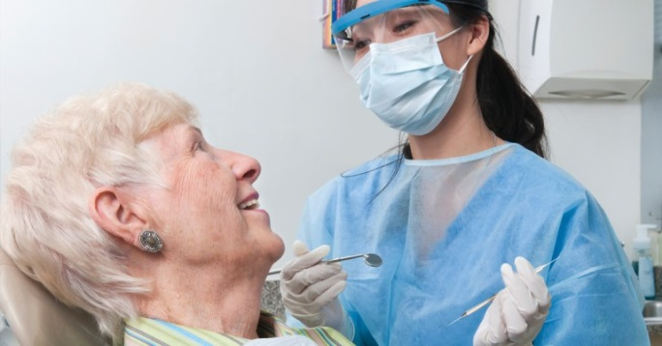
Free Dental Care for
Senior Center Members!
Procedures offered:
Cleanings
Fillings
Extractions
X-rays
Panorex
Chester County
Delaware County
Community Volunteers in Medicine (CVIM)
300 B Lawrence Drive
West Chester, PA 19380
**Bus route available**
If you are a member of a Chester or Delaware County Senior Center and are interested in CVIM dental care, please call:
Alberta Landis, VP of Dental Services
610-836-5990 ext 107

Slide 2
Chester & Delaware County Senior Centers
Chester Senior Center
(610) 497-3550
721 Hayes St, Chester, PA
Coatesville Senior Center
(610) 383-6900
250 Martin Luther King, Jr. Blvd.
Coatesville, PA
Downingtown Area Senior Center
(610) 269-3939
503 Lincoln Hwy, Thorndale, PA
Friendship Circle (Darby) Senior Center
(610) 237-8100
1515 Lansdowne Ave, Darby, PA
Good Neighbor (Sharon Hill) Senior Center
(610) 586-8170
1085 Hook Rd, Sharon Hill, PA
Great Valley Senior Center (Malvern)
(610) 889-2121
47 Church Road, Malvern , PA
Havertown Senior Center
(610) 446-2070
401 Brookline Blvd, Havertown, PA
Hometown (Media) Senior Center
(610) 566-0505
302 S Jackson St, Media PA
Kennett Area Senior Center
(610) 444-4819
427 S Walnut St, Kennett Square, PA
Oxford Senior Center
(610) 932-5244
12 E Locust St, Oxford, PA
Phoenixville Senior Center
(610) 935-1515
153 Church St, Phoenixville, PA
Schoolhouse (Folsom) Senior Center
(610) 237-8100
600 Swarthmore Ave, Folsom, PA
Surrey Services For Seniors (Devon)
(610) 647-6404
60 Surrey Way, Devon, PA
Upper Darby Senior Center
(610) 734-7652
326 Watkins Ave, Upper Darby, PA
Wayne Senior Center
(610) 688-6246
108 Station Rd, Wayne, PA
West Chester Area Senior Center
(610) 431-4242
530 E Union St, West Chester, PA

