Slide 1
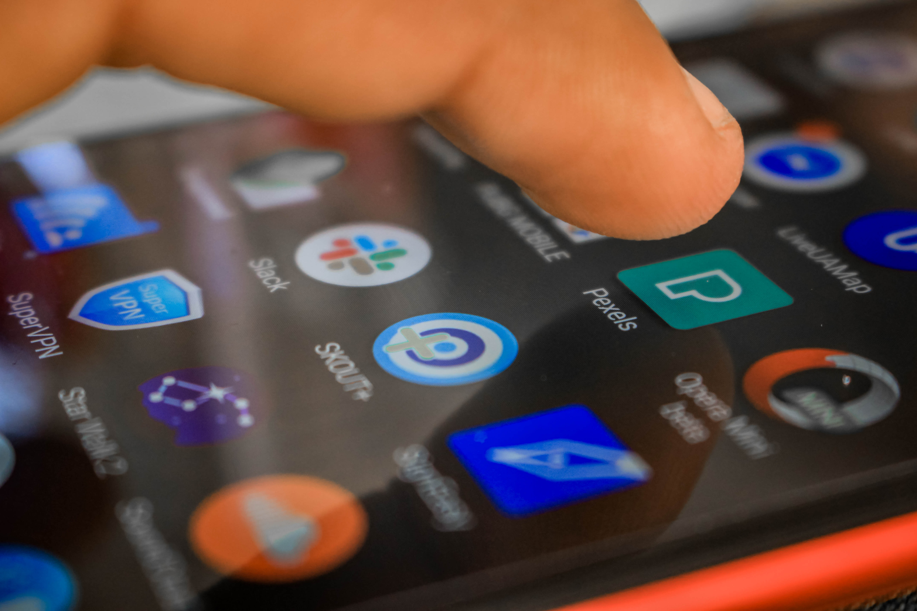
Smartphone set-up for the tech-averse
This Photo by Unknown Author is licensed under CC BY
Considerations, tricks, and tips for an individual new to cellphones

Slide 2
Barriers
The tech gap
Negative opinions about social media
Resistance to new/fear of unknown
Fear about internet safety
Fear of breaking the device
Memory challenges
Physical challenges – low vision, lowered tactile functioning, hearing loss
Cost
Negative past experiences

Slide 3
Begin with one idea in mind…
Simplicity!
Don’t attempt to include everything possible or things that might be needed someday
Don’t be guided by all the things YOU would use
Look for visual simplicity
Aim for clearly labeled icons
Things can be added over time
Right now – make things as intuitive as possible

Slide 4
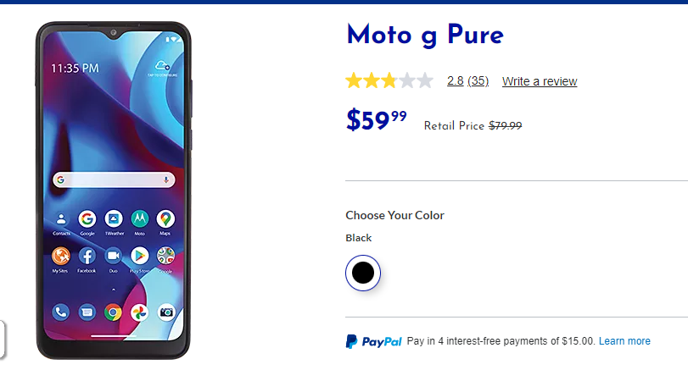
First Step
Buy the phone!
These set up directions are for an Android phone, but googling will get you the same actions on an Iphone.
Phones that can do everything a senior might need can be had at a reasonable price.
Re: Jitterbug

Slide 5
Start with the case
Choose a very bright color. This will make it easy to spot on a jumbled table and set it apart from any other cellphones in the house.

Slide 6
And a small purse
Just large enough to hold the cell phone, charger, earphones, and cheat sheet that can be put in a regular size purse
This establishes a process & keeps everything together in one place
For a gentleman, perhaps a faux leather case that has a more manly look.
This Photo by Unknown Author is licensed under CC BY-SA-NC

Slide 7
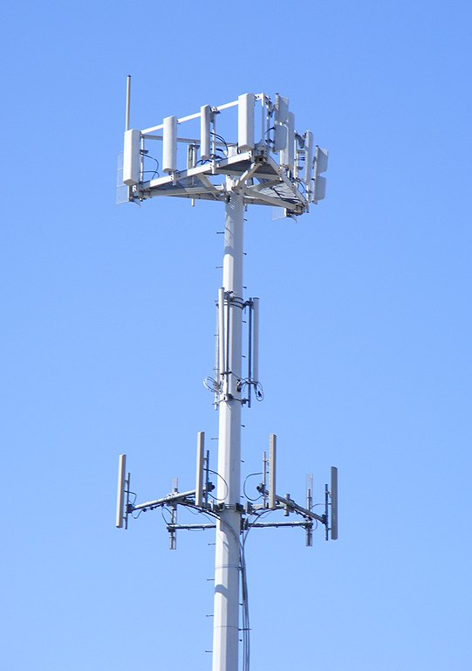
Cell service
If needed, set up the cell service. Hold on to the account log in credentials in case you need to “find my phone” or check on charges.
The person you are helping may lose the credentials or forget where he/she put them.
Tracphone has a lot of reasonable options. Just keep in mind the device should be bought at Tracphone.
This Photo by Unknown Author is licensed under CC BY-SA

Slide 8
Connect to Wifi
Connect to the individual’s wifi, and then go into the network settings and set it to “connect automatically”
This way, the senior does not need to continually find the network and turn on and enter password
The phone will connect to public wifi without a lot to do
Enable Wi-fi calling when cellular is not available

Slide 9
Start getting rid of preloaded apps
The phone will be filled with all sorts of random apps
Either delete those that are not critical or gather together in a folder and move to a 2nd or 3rd screen so they are out of the way.
If not deleting, go into settings and turn off the apps’ notifications
Get rid of things that might lead to trouble, like online shopping or social media not yet established

Slide 10
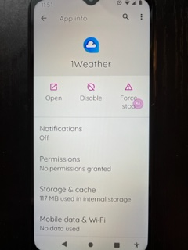
Now look at what apps are left
Fix notifications
Only the most critical notifications like voicemail or text received should be left on
Notifications cause pop ups that seniors often
don’t know how to get rid of
Notifications can lead a person to believe that they are being asked to do something, or that there is a problem.

Slide 11
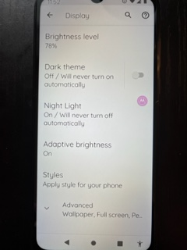
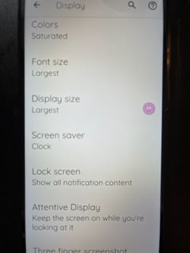
Adjust the display for easy reading
Brightness, dark or light theme, night light, styles, color saturation, font size, display size etc.

Slide 12
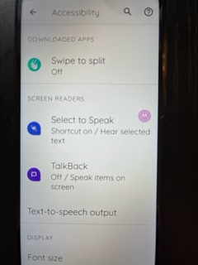
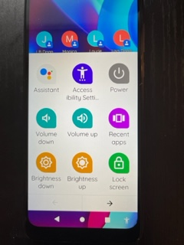
Accessibility Settings
Screen readers for low vision
Closed captioning for hearing
loss
Change height of keyboard
Accessibility man icon handy
for those with tactile difficulties

Slide 13
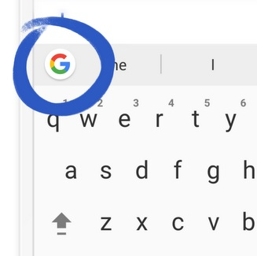
Think about downloading the G Board App
This will allow the user to write emails and texts using their voice

Slide 14
Think about the screen lock
Seniors & people with disability often have difficulty getting the phone unlocked to use.
They may not remember the 4-digit code or how facial recognition works.
If the senior is not going to do banking or enter any sensitive information into the phone, then it may work better to take security off
No security is an advantage in medical emergencies
This is a judgment call based on the individual

Slide 15
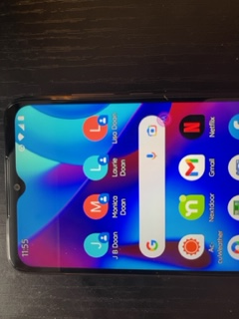
Contacts
After adding the necessary contacts, look for a three-dot option or dropdown that allows you to add to the home screen. This way, the individual merely touches the person they want to call.

Slide 16
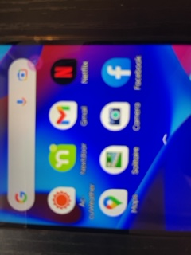
Enable Google Speak
The individual can tap the microphone and then search Google by speaking, rather than typing

Slide 17
Use a ring tone that sounds familiar
Many of the tech-averse will have no idea what’s happening if their phone starts playing a harp
Make the incoming call ringer sound like a landline
Texts can be a simple ding
Set the alarm tone to sound like an alarm clock
Think about how the person will intuitively
understand what a tone represents
Adjust volume to the individual’s needs
Use vibrate and/or flash if appropriate

Slide 18
Consider location sharing
Go to the settings on Google Maps and enable sharing, choosing who the location should be shared with.
This is a setting that should be thoroughly discussed and agreed upon with the individual – everybody has the right to privacy.

Slide 19
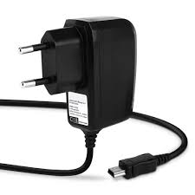
Pick ONE place the charger will be
Choose something accessible
Avoid plugs that require bending over
Label the charger to remind the person what it’s for
Remind them to put it in their little phone purse and take it when traveling or going to the hospital

Slide 20
Emergency info/medical info
Add important doctors, like a GP or cardiologist
Add medication list (dated) and pharmacy
Add allergies and blood type
Add important notes about your loved one.
Family contacts and POAs
If the phone is unlocked, EMS and medical personnel will be able to access the information
Do not add Medicare number or SSN
This Photo by Unknown Author is licensed under CC BY-NC

Slide 21
Security
If you are concerned with phishing and malware: Malware Bytes, or spam calls: Robokiller
Educate on basic security: SS # and Medicare #
In doubt/confused/being threatened/don’t know what it is? STOP and HANG Up - call your go-to tech person
If the individual consents, allow the POA to have passwords to monitor emails etc

Slide 22
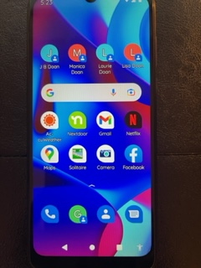
Arrange the screen in a way that makes sense
Institute some kind of order to the apps you have decided to keep.
Make sure all apps are logged into, home address set on maps, etc

Slide 23
Teaching
Don’t attempt everything at once!
It’s a phone, so start with making and answering calls and how to charge the phone.
Make sure they know how to get back to the home screen.
As a person becomes comfortable with one task, they will be more open to others.
Eventually, they will click on other icons and be willing to learn other things like texting, maps, social media.
This Photo by Unknown Author is licensed under CC BY-NC-ND

Slide 24
Learning Styles - VARK
Visual, Auditory, Reading, Kinesthetic
Pidgeon-holing has been proved unhelpful
What does Scuba Diving have to do with it?
The Professional Assoc of Dive Instructors (PADI) strategy of stacking can help a person better remember instructions and processes

Slide 25
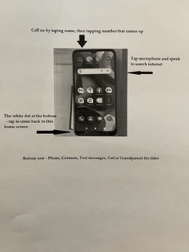
Make a cheat sheet
Compose some simple directions and make sure the person knows how to always get back to the home screen
Write up a list of basic “how
to’s”

Slide 26
Cheat sheet written directions
You don’t have to turn the phone off – just plug in to charge when battery gets low
To wake up after screen has gone dark – press second button down on right side of the phone, then use finger to swipe from bottom to top of the screen
To get back to the home screen – tap the white circle at the bottom of the phone
To call one of us, tap the circle with our name and then tap the phone number
To search Google or launching an action, tap the microphone inside the wide oval in the middle of the screen that has a G to the right side and microphone on the left. Just say what you’re looking for. Examples of launching an action: Call Lisa. Open Netflix. Open Solitaire. Examples of searching Google: What is the weather in Phoenixville. Recipe for chicken soup.
Your phone number is: 267-XXX-XXXX You can also find it in your Contacts, which is the blue icon with a white person inside located in the same row as the phone
To call Go Go Grandparent – press the green icon with the G on it in the bottom row then press the phone number. After they answer, you can press 0 to speak to a live person.
To adjust volume – use the top button on right side of the phone. Pressing the upper part will increase the volume and pressing the lower part will lower it.

Slide 27
Last step
Write the phone number in large numbers and tape it to the back of the phone with sturdy mailing tape.
Also add the individual’s contact information with this cell number in the contacts

Slide 28
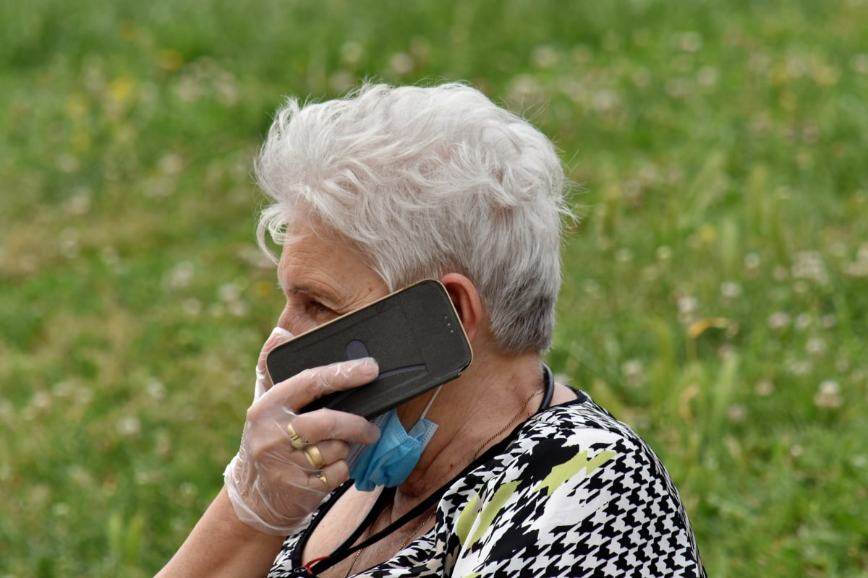
And then…
Expect ongoing questions
Expect reports like, “Well, it’s just not working/I broke it/it’s all messed up
As they gain confidence and skill, try adding new apps the person might like and even attempting to use more than one screen to store them
You weren’t the best driver on your first day. Assimilating a new skill is a process.

Slide 29
Questions?
Contact me: Elizabeth Doan buckschestermontgomerylink@aim.com
Or visit buckschestermontgomerylink.weebly.com

